Slide 1

Trends to Value Chains: Circular Economy
Conferência ETHOS 360º
Peter Lacy
Sustainability Global Lead
London, UKI

Slide 2
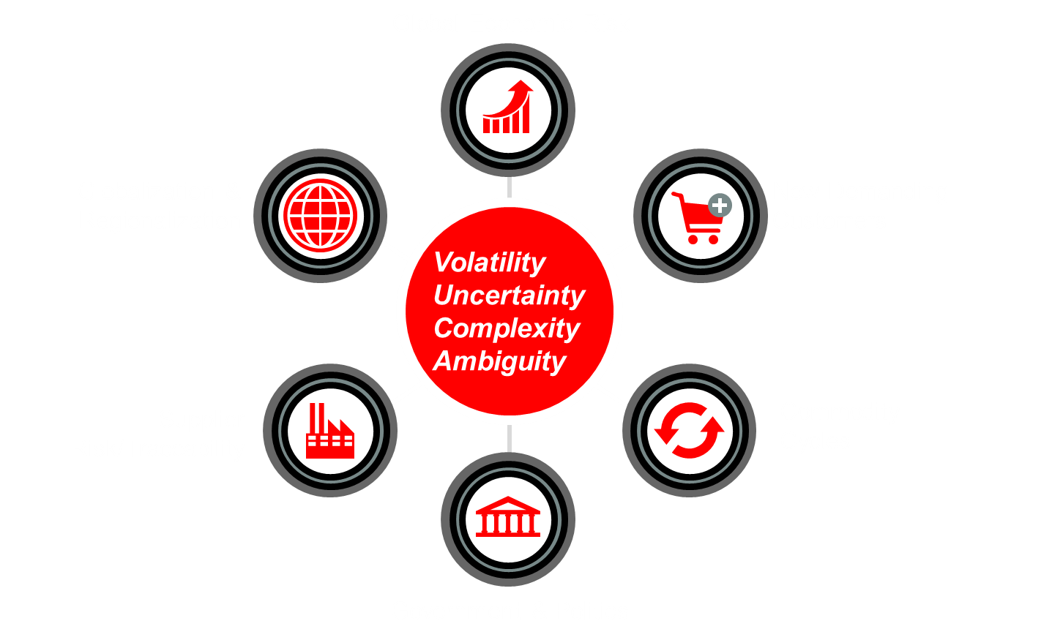
Major market forces and uncertainties make growth challenging in a margin squeezed environment

Slide 3
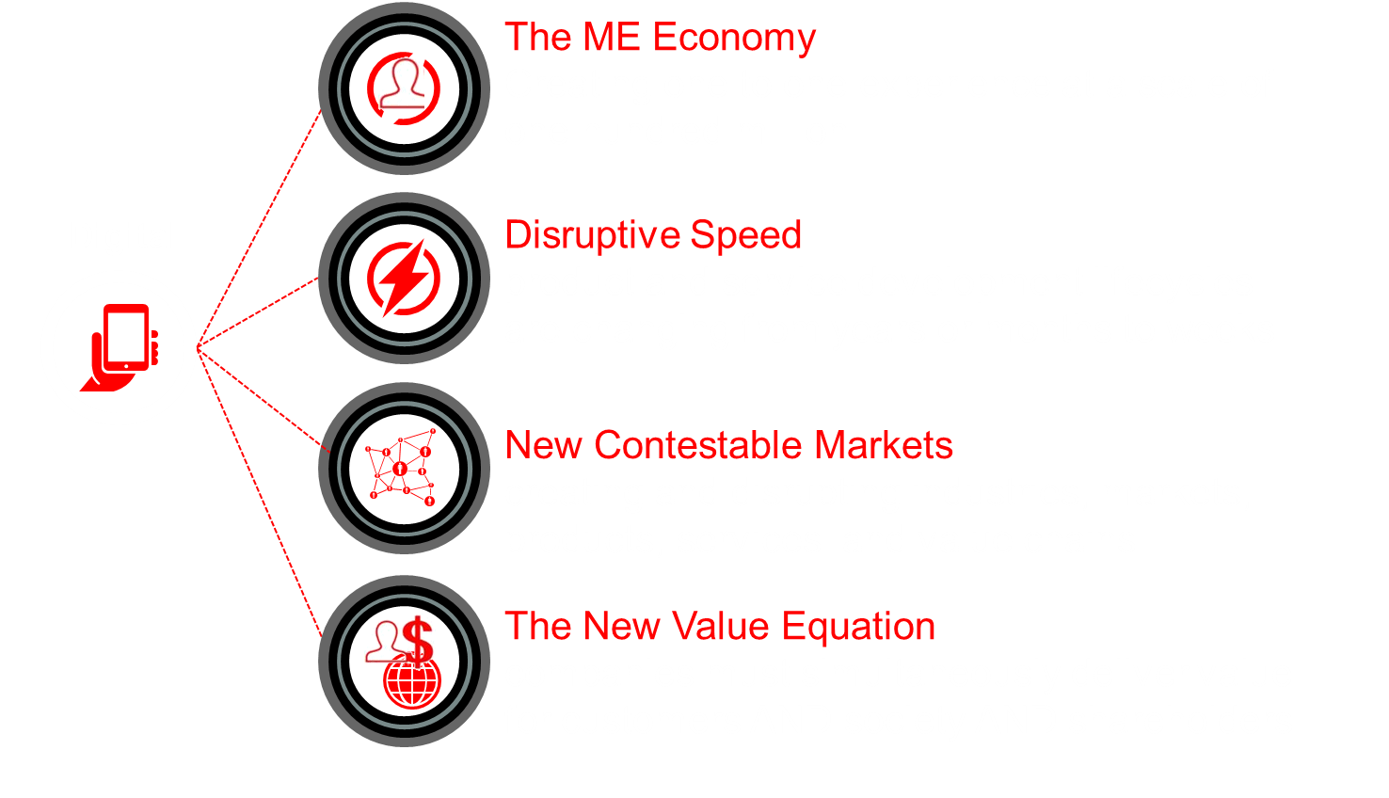
Digital is creating extraordinary new challenges and opportunities

Slide 4
Competing to Win in this complex business environment requires a “Triple A” Advantage
To create superior value compared to competitors companies must be:
Agile
capabilities, cost base and operating model
Adaptive
growth and innovation engines, exploiting the ecosytsem
Aligned
with stakeholder demands

Slide 5
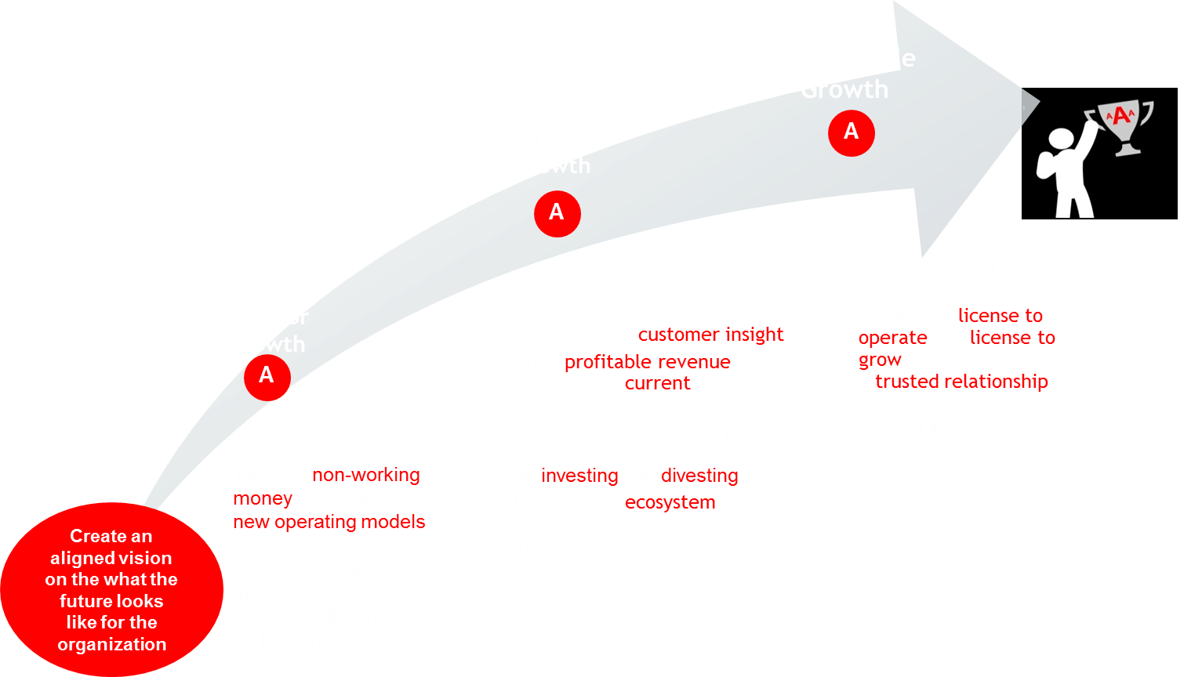
Creating the Triple A Advantage is a Journey – where to start on the journey is unique to each organisation

Slide 6
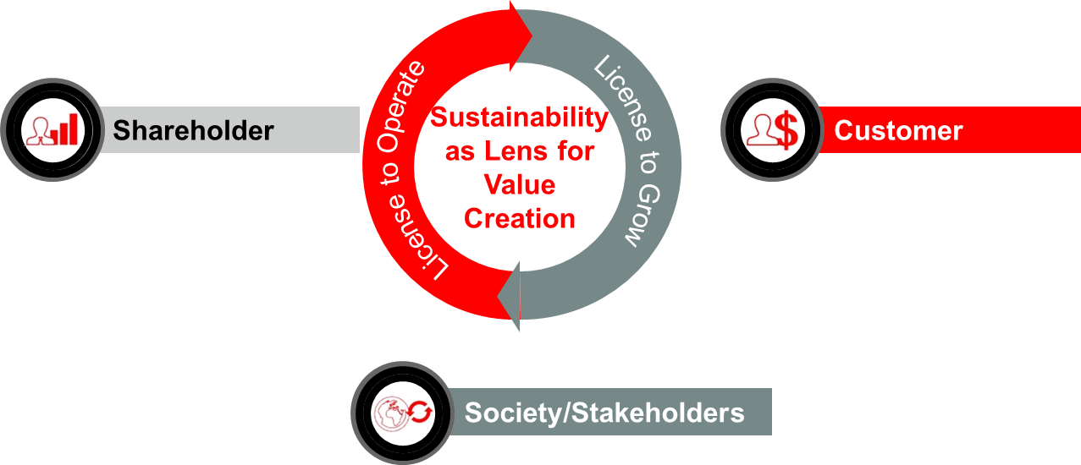
Accenture’s “Responsible Growth Framework
Securing your license to operate, innovate & grow for the long-term. Not just acting in short-term self-interest

Slide 7
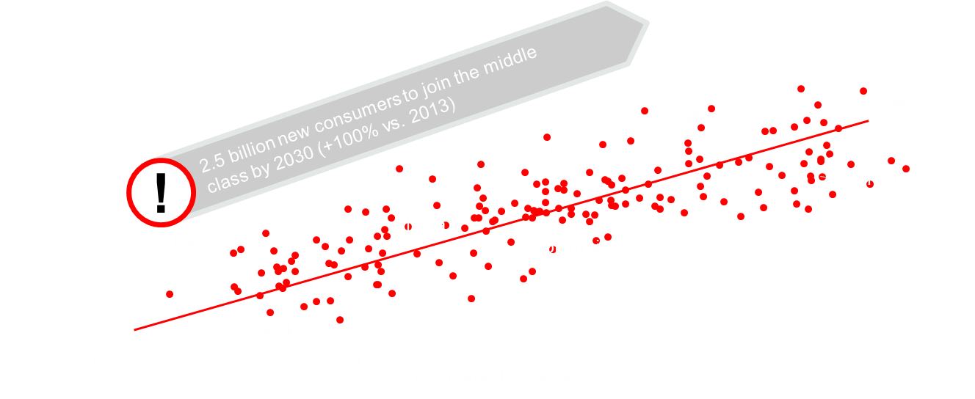
The link between economic development and resource use is strong
Log plot of Resource use and Economic development (2010, 166 countries)¹
1 SERI and Dittrich, M. (2014). Global Material Flow Database, World Bank (2014) GDP per capita in current US$ (outliers Mongolia & Bahamas removed)
2 OECD Development Centre, Working Paper No. 285, The Emerging Middle Class in Developing Countries

Slide 8
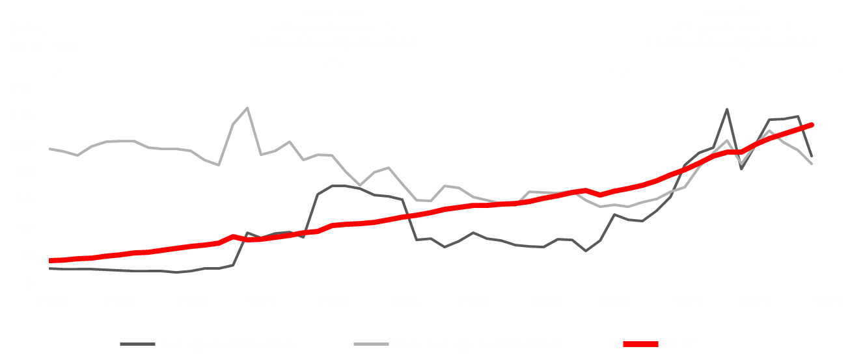
The supply / demand imbalance is bad news for business
GDP and commodity price development 1960-2014
Sources: Accenture analysis, The Conference Board, ‘Total Economy Database – Key Findings’, January 2014, http://www.conference-board.org/data/economydatabase/,
The World Bank, ‘World Bank Commodity Price Data (The Pink Sheet)’, December 2014, indexmundi commodities http://www.indexmundi.com/commodities

Slide 9
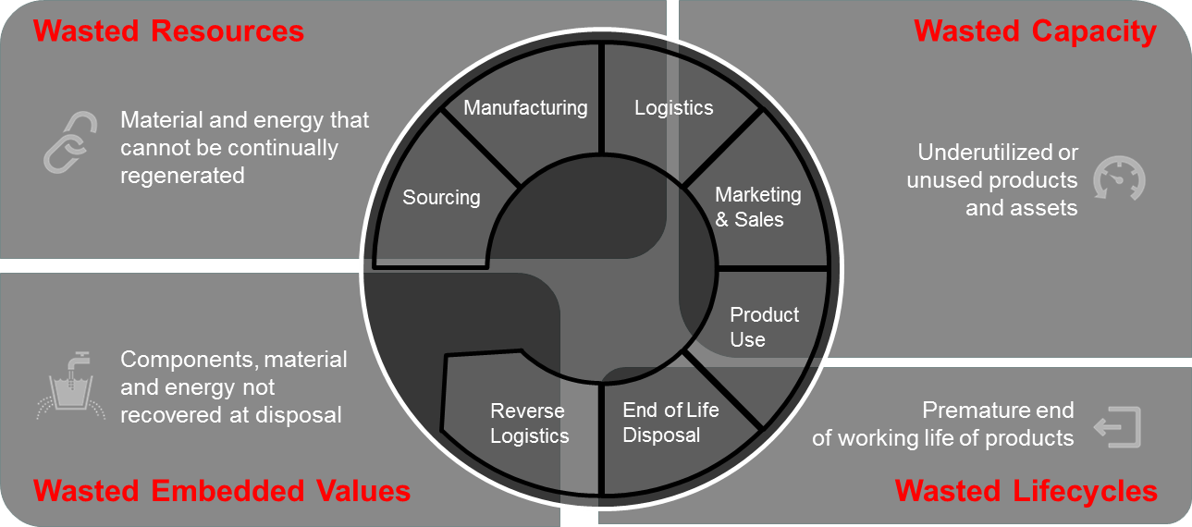
A 4-dimensional view on waste is required to see the real potential

Slide 10
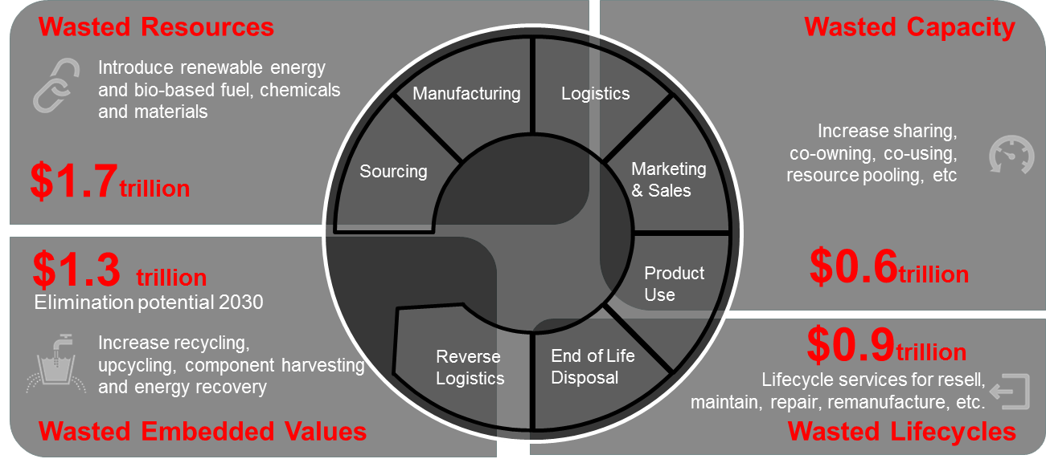
A 4-dimensional view on waste is required to see the real potential

Slide 11
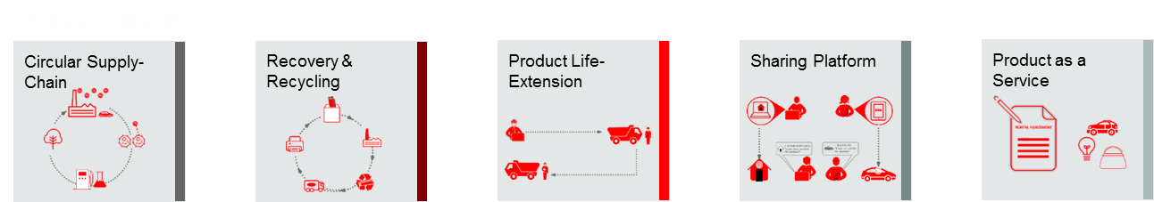
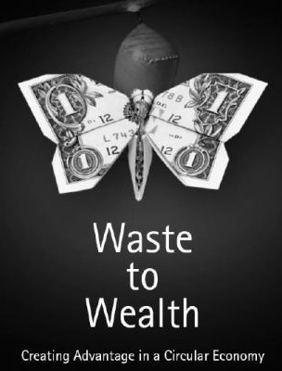
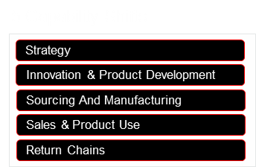
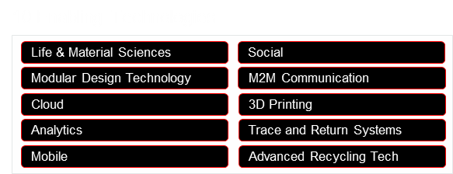
Accenture and WEF Young Global Leaders have studied 120 successful circular pioneers
120
Case
Studies
50
Executive
Interviews

Slide 12
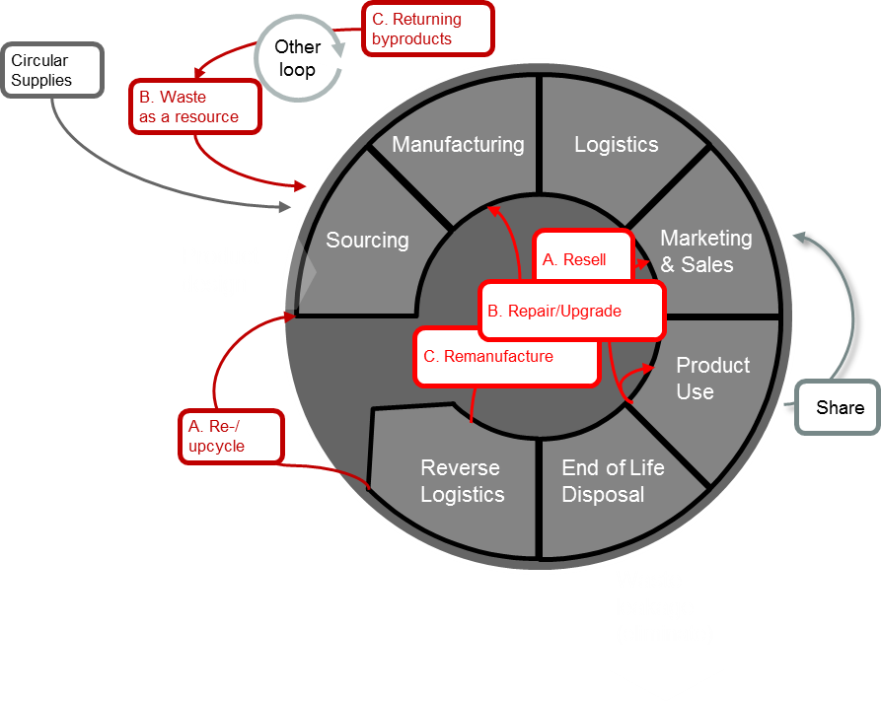
In our research we found five circular economy business models
Business models of the circular economy
Circular Supply-Chain
Recovery & Recycling
Product Life-Extension
Sharing Platform
Product as a Service

Slide 13
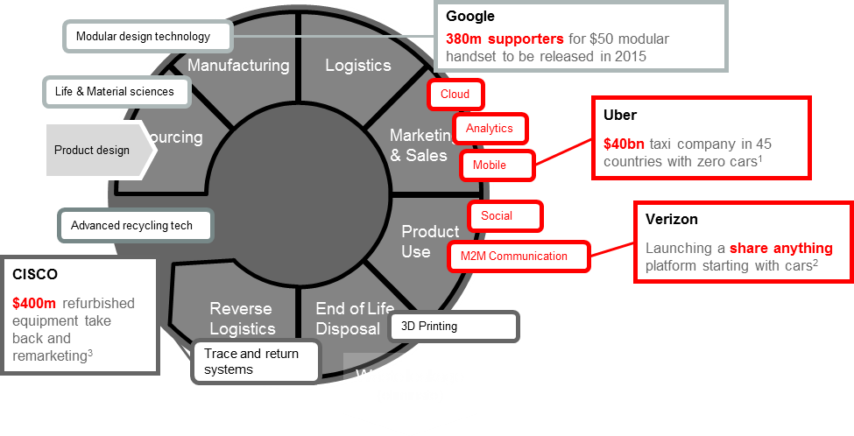
Three types of technologies are key
Circular Economy enabling technologies
Digital
Enabling entirely new ways to access and understand product use-phase and aid customers in use efficiency
Hybrid
Enabling moving physical objects back and forth from value chains with digital services to drive down cost
Engineering
Enabling production and supply of new types of resources as well as new product designs to use them
1 Ingrid Pan, ‘Uber’s Breakneck Growth: How the Company Grows and Makes Money’, YAHOO!Finance, June 23, 2014, http://finance.yahoo.com/news/uber-breakneck-growth-company-grows-210007173.html.
2 Barry Levine, ‘Verizon plans to create a sharing platform for virtually anything – not just cars’, Venture Beat, September 8, 2014,
http://venturebeat.com/2014/09/08/verizon-plans-to-create-a-sharing-platform-for-virtually-anything-not-just-cars/
3 Cisco, ‘Corporate Social Responsibility Report’, 2013, accessed November 24, 2014, http://www.cisco.com/assets/csr/pdf/CSR_Report_2013.pdf.

Slide 14
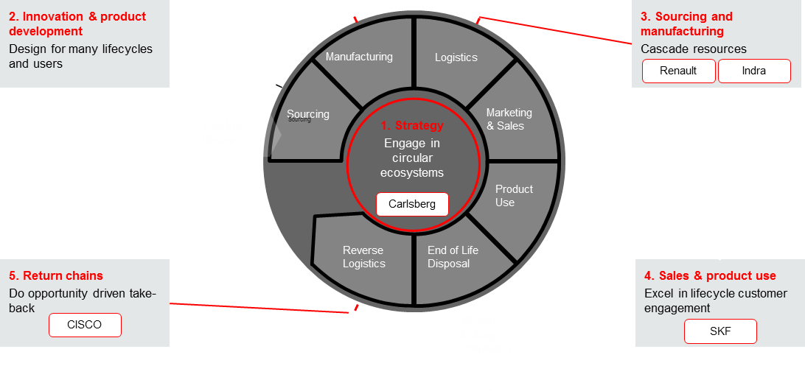
Leading adopters experiment with 5 new business capabilities
Circular Economy capability shifts
Source: Circular Economy book project

Slide 15
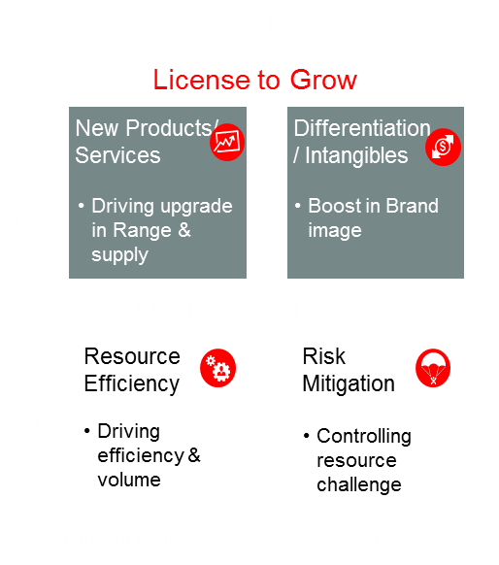
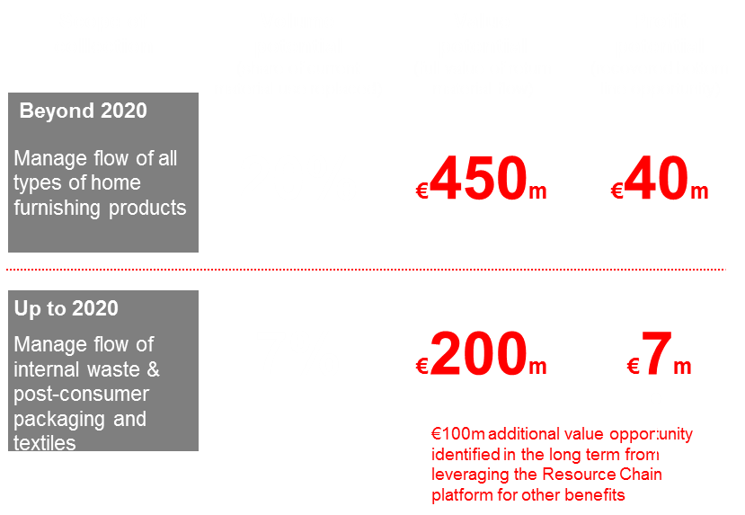
Case 1
How Accenture is improving a global consumer goods company ‘License to Operate & Grow’ through Circular Economy
We have identified a direct potential of up to €40m and to cover 20% of current material use with secondary sources

Slide 16
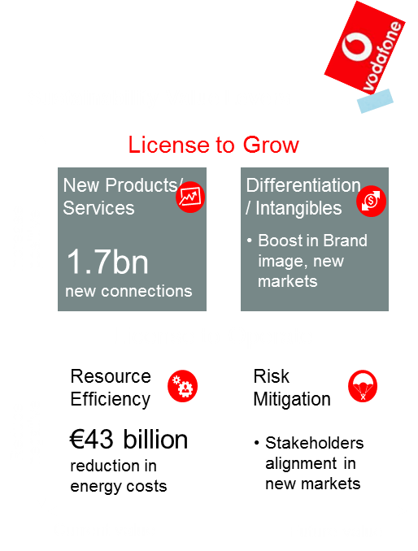
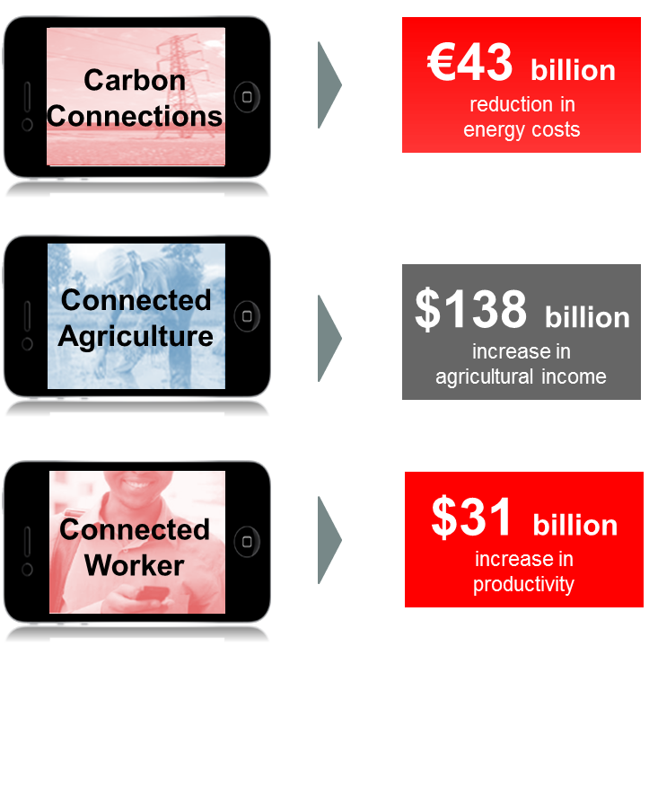
Case 2
How Vodafone is using sustainability challenges as an opportunity for growth in new markets for digital products & services
Accenture Strategy identified $28bn in potential new revenues across 30 opportunities, as well as significant outcomes for society

Slide 17
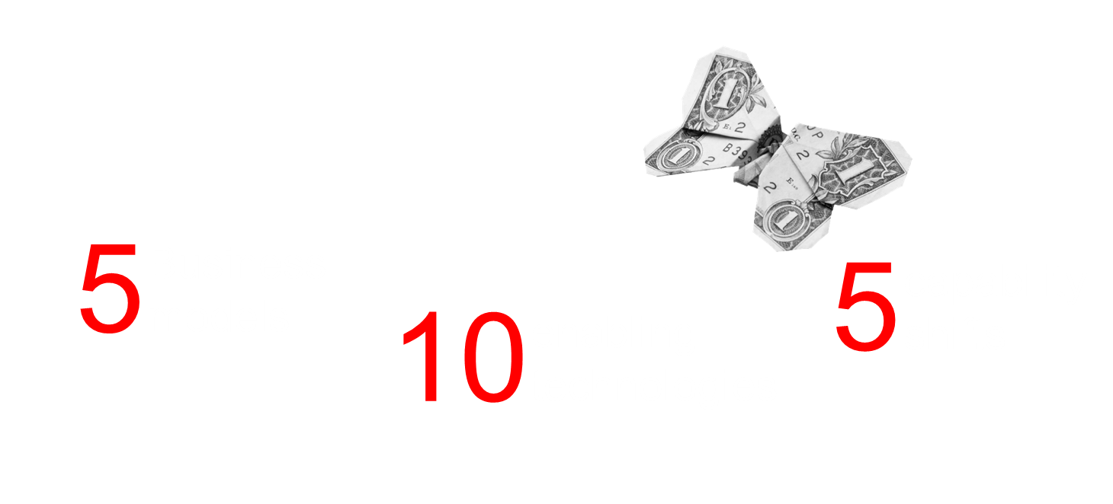
Conclusion
$4.5 trillion size of prize through …
Five questions to get you started:
What are the risk and opportunities of moving to a Circular Economy?
What is the core value we deliver to customers?
How can digital and other technologies deliver this value in new ways?
What new capabilities are needed to turn the value chain circular?
How do we time action to capture low hanging fruit and long term disruption?

Slide 18
www.accenture.com/sustainability

